Slide 1
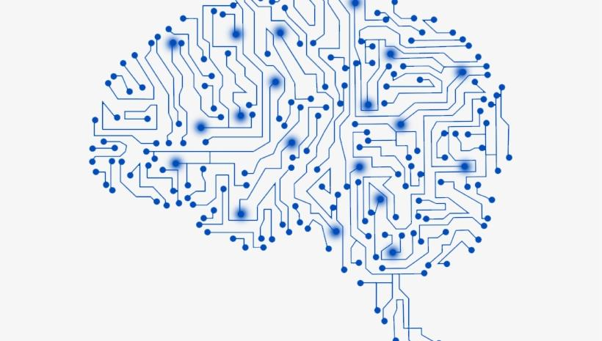
Interactive Coventry Ltd is a spin out of
Coventry University, UK

Slide 2
Expertise and Experience
Artificial Intelligence
Big Data Analysis
Natural Language Processing
Software Development
PCB Design
INNOVATION
Machine /
Deep Learning
Computer Vision
Internet of Things
Enterprise System design and integration
Research

Slide 3
What do we offer ?
System Integration
Our team of engineer will bring together the benefits of software, hardware and network integration to provide customers with a unique and robust solution.
Training
Whether your team lacks required expertise or needs more inspirations, we’d be happy to share our experience in trending machine learning frameworks.
Development Services
Whenever time-to-market is crucial, our experts will help you to create an innovative solution tailored to the needs of end users. Our solutions are developed by experts in the field of computer science and AI.
Consultation
Problems with technology bottlenecks or need help with understanding what AI/ML brings in?
Need extra resources and experience to complete a project?
POC and MVP
Validating your business ideas - our machine learning experts can help you to understand the value artificial intelligence can bring to your organisation. We will review your data and advise you on how to optimize the benefits and achieve your business goals. This early feedback can prove invaluable and allow you to gain competitive advantage.
Research
Need to develop a new technology, or have a problem that cannot be solved with currently available technology. Our team of renown professors and researchers conducts world leading research in a number of challenging areas.

Slide 4
Route to a complete AI solution
01
Business needs
04
AI model implementation
Discuss with our experts to design business use cases and find the best solutions for your organization.
Our team will develop a bespoke solution capable of achieving the required functionality and performance.
02
Problem definition and requirements evaluation.
05
Minimum viable product (MVP)
Leverage the available data and data sources to evaluate the existing technology and custom state of the art solutions.
Our team will integrate the AI model and produce a MVP with enough features to satisfy early customers, and provide feedback for future product development.
03
Solution candidates
06
Elaborated options
We evaluate the available solutions check for the fitness and whether the solution satisfy business goals and requirements of our customers
Our team will deploy the final solution either in the cloud or on premises. We will integrate it within the existing systems and processes, as well as ensure that the product quality improves over time based on the incoming data.

